Slide 1




AI reinvention made real
Accenture Innovation Challenge 2026
Copyright © 2025 Accenture. All rights reserved.
‹#›
Notes:
1

Slide 2

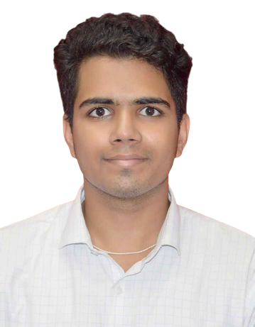





ControlPlane.ai
Team details
TEAM NAME: 23je0841
Sahil Bhavesh Choudhary
Mayank Raj
College: IIT (ISM) Dhanbad
Stream: B.Tech - Petroleum Engineering
Year of graduation: 2027
College: IIT (ISM) Dhanbad
Stream: B.Tech - Petroleum Engineering
Year of graduation: 2027
Saket Kumar Singh
College: IIT (ISM) Dhanbad
Stream: B.Tech - Petroleum Engineering
Year of graduation: 2027
Repo Link: Click Here
Demo/Prototype Video link: Click Here
3

Slide 3













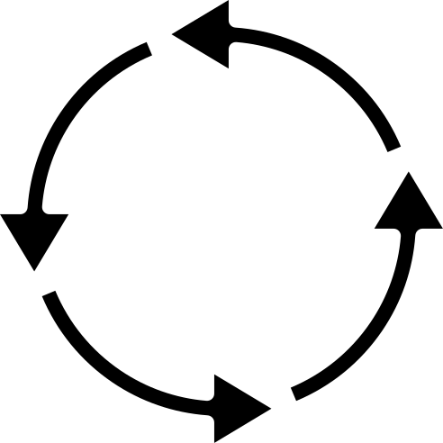





ControlPlane.ai
ControlPlane.ai:
Sidecar Orchestration
Architecture & Network Interception
Client Buffer
(Passthrough)
The Problem: After the Fact Discovery
Current AI deployments lack real-time telemetry across inference planes. Waiting for user feedback to identify confidently wrong, expensive, or unsafe outputs is a critical operational failure.
ControlPlane.ai
Redis Streams Bus
Sidecar Proxy
  Runs deterministic checks inline
  Forwards stream to client instantly
(Fork via XADD)
Enterprise
App
OpenAI / Anthropic Payload
Technical Approach
Responsibilty Agent
Parallel Execution & Mitigation Flowchart
Edit
  Deep PII Scanning
  Toxicity Classifiers
Inline Mask
Built on Python and Starlette, a non-blocking sidecar proxy instantly forwards LLM streams while parallel micro-agents evaluate risks asynchronously via a Redis event bus.
Redis Streams Bus
Cost Agent
Allow
  Token Tracking
  Budget Burn Rate
Pass-through
Governance & Policy Layer
Dynamic Action Engine
Continuous Feedback Loop
Performance Agent
Configures rules by geography/use case
Assigns confidence scores to anomalies
Block
Routes human overrides to improve detection
  Grounding Checks
  Hallucination Risk
  Escalate & Log
  Users download detailed report

Slide 4




ControlPlane.ai
Competitive Matrix & Commercial Opportunity
$42.2B
Feature | Legacy Reactive Logging | In-Line Blocking Proxies | ControlPlane.ai
User Latency Impact | Zero (Post-generation) | High (Blocks generation) | Zero (<50ms TTFT)
Evaluation Timing | "After the Fact" | Synchronous / Bottlenecked | Asynchronous / Parallel
Mitigation Protocol | Reporting only | Binary (Block/Allow) | Pass, Auto-Edit, Block
Cost Telemetry | Delayed billing sync | Heuristic estimations | Real-time token burn
Projected Global enterprise AI market by the end of 2026, while the Global footprint to $539.5B.
Estimated 15% ($6.3B) allocated to security, compliance, and observability.
$3.5B
SAM for LLM - specific telemetry and guardrail globally.
Capturing the $3.5B SAM for LLM telemetry by targeting the security and compliance budgets of Fortune 500 AI deployments.
Growing at 45% CAGR as Gen AI moves from sandbox to Production.
A conservative early capture yields a $150M-$200M near term revenue opportunity.
Usage-based SaaS billed per million intercepted tokens, mirroring the cost structure of upstream providers like OpenAI and Anthropic.

Slide 5





ControlPlane.ai
Mitigation, Traction & Roadmap
Risk & Mitigation
01
Traction
  Live Deployment: Functional 5-service Docker Compose topology mimicking real enterprise deployment.
  Core Proxy: Streaming pass-through and mid-stream teardown fully operational.
  Micro-Agents: Performance, Cost, and Responsibility agents running 8 deterministic scenarios via an offline mock provider.
Pass-Through (Low Risk)
Stream proceeds uninterrupted; background checks confirm safety. < 50ms TTFT overhead.
Roadmap
Phase 1 | Week 1 | Integrate fine-tuned neural cross-encoders.
Phase 2 | Week 2 | Add production vector stores & exact tokenizers.
Phase 3 | Week 4 | Launch SSO, auth, and multi-tenancy.
02
Auto-Edit (Medium Risk)
Luhn-validated Regex/NER masks PII mid-stream before flushing the buffer.
03
GTM
  Developer-First Land & Expand: Drive bottom-up adoption by targeting developers with the zero-key mock provider demo.
  Enterprise Scaling: Transition free developer usage into top-down, multi-tenant deployments mandated by internal security and DevOps teams.
Block & Escalate (High Risk)
Proxy forcefully tears down the TCP/WebSocket connection mid-stream and fires a webhook to the live HITL Dashboard.
Open source local proxy
Cloud self serve
Enterprise SSO/VPC deployment

Slide 6

Thank you
Repo Link: Click Here
Demo/Prototype Video link: Click Here
Team 23je0841: Engineered by Saket, Mayank, and Sahil at IIT (ISM) Dhanbad.
Copyright © 2026 Accenture. All rights reserved.
‹#›

